Slide 1

Case Studies and Practical Scenarios

Slide 2
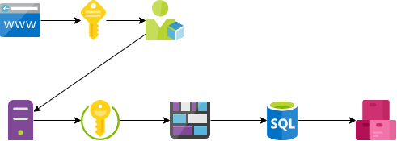
Data Masterminds
New Client Onboarding

Slide 3

Automating Azure Infrastructure with Bicep
Introductory slide

Slide 4



Overview
Case study overview
Infrastructure overview
Automation overview
Briefly introduce the case study and goals
Overview of the Azure infrastructure and resources involved
Briefly explain how Bicep helps automate the infrastructure
In summary, this slide will provide a high level overview of the case study, infrastructure, and automation with Bicep templates.

Slide 5

Challenge
The team faced a challenge of creating 150+ resource groups while ensuring consistency across the infrastructure. This required developing an efficient automation strategy leveraging Bicep, an Infrastructure as Code tool.

Slide 6




Solution
Overview
Bicep Templates
Azure DevOps
Automated Resource Group Creation
Introduce that the solution was to use Bicep templates controlled by Azure DevOps to automate resource group creation.
Explain what Bicep templates are and how they allow declarative infrastructure-as-code.
Explain how Azure DevOps provides version control, CI/CD pipelines, and automation for Bicep templates.
Explain how Bicep templates in Azure DevOps automate resource group creation instead of manual processes.

Slide 7



Benefits
Faster provisioning
Consistency
Error reduction
Bicep automates infrastructure deployment so you can spin up resources faster
Bicep provides reusable components so you can ensure consistency across deployments
Bicep's strong typing and validation reduces errors from manual processes
By using Bicep to automate infrastructure deployments, you can deploy faster, with more consistency, and fewer errors.

Slide 8



Azure DevOps Integration
Configure DevOps Project
Create Build Pipeline
Configure Release Pipeline
Created a new Azure DevOps project and configured repository, builds and releases.
Built a CI/CD pipeline in Azure DevOps to compile Bicep templates and publish artifacts.
Configured a release pipeline to deploy Bicep artifacts to Azure using service connections.

Slide 9
Bicep Template Structure
Parameters
Variables
Resources
Declare parameters at the root level to accept values for resources.
Declare variables to reuse values across the template.
Define the Azure resources to provision in the resource section.
Modules
Outputs
Break the template into reusable modules for organization.
Return values from the deployed resources via outputs.

Slide 10
Customer Onboarding
Configure parameters
Assign parameters
Deploy resources
Created parameter files to store configuration values like VM size, region, etc.
Assigned parameter values in ARM templates that create resources.
Ran deployments using ARM templates with parameter files to deploy resources.

Slide 11
Azure DevOps Integration
Configure DevOps Project
Create Build Pipeline
Configure Release Pipeline
Created a new Azure DevOps project and configured repository, builds and releases.
Built a CI/CD pipeline in Azure DevOps to compile Bicep templates and publish artifacts.
Configured a release pipeline to deploy Bicep artifacts to Azure using service connections.

Slide 12



Results
Faster deployments
Consistent environments
Scalable
Bicep templates allowed deployments in minutes compared to days with manual setup
Bicep templates ensure identical configurations across dev, test and production
Bicep templates make it easy to scale deployments across regions and scale up or down on demand
By using Bicep to automate our Azure infrastructure we achieved faster, consistent deployments that can scale on demand.

Slide 13
“Curiosity may have killed the cat, but it keeps asking questions and finding answers. Ask questions, stay curious.”
TYSON YUNKAPORTA

Slide 14



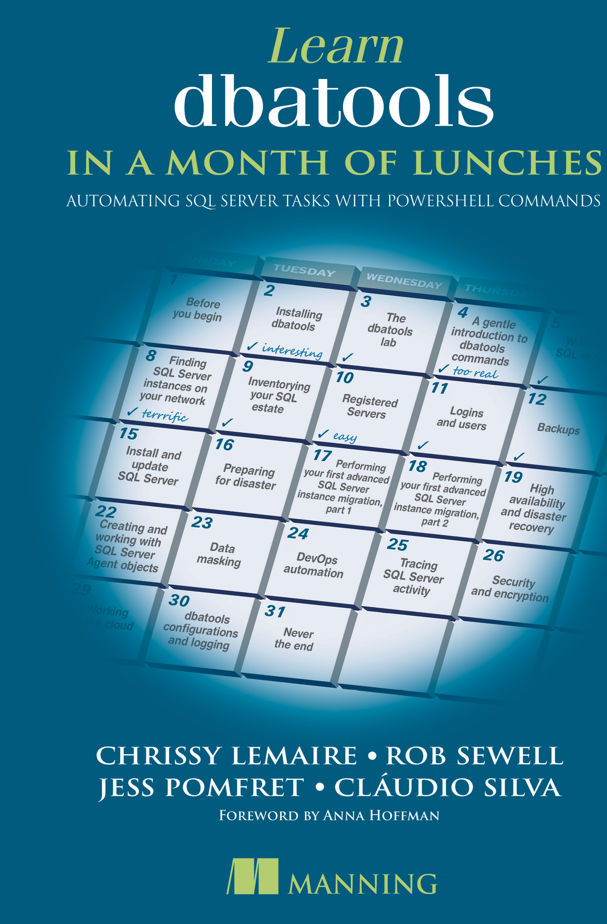


jpomfret7@gmail.com
Jess Pomfret
She/Her
I'm a data platform engineer with a passion for automation, proper football, and fitness. I enjoy contributing to open-source software and I'm a maintainer for dbatools.
DATA MASTERMINDS
Data Platform Engineer
DUAL MICROSOFT MVP
Cloud and Data Center Management
Data Platform
JESSPOMFRET.COM
Notes:
J

Slide 15

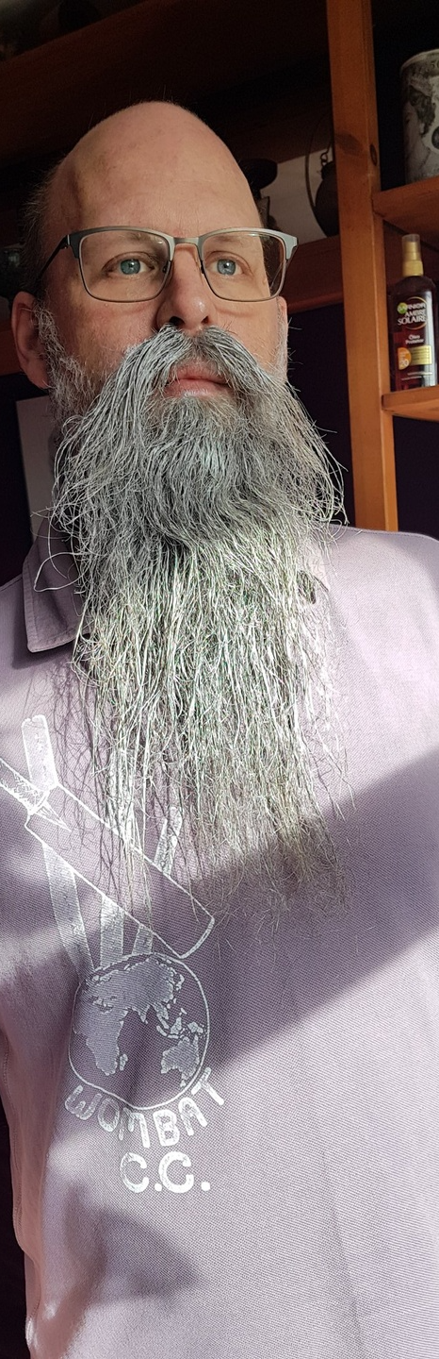


Rob Sewell
mrrobsewell@outlook.com
He/Him
I was a SQL Server DBA with a passion for Powershell, Azure, Automation, and SQL (PaaS geddit?) (And a sense of humour (and a habit for writing inside braces)). Now I just help other people with those (not the braces bit).
SEWELLS CONSULTING LTD
Beard Twizzler
DUAL MICROSOFT MVP
Data Platform
Cloud and Data Center Management
robsewell.com
Notes:
R

